Slide 1
Case-Based Reasoning
BY: Jessica Jones
CSCI 446

Slide 2
Overview
Definition of Case-Based Reasoning
Origin of CBR
CBR Working Cycle
Knowledge Containers for CBR Systems
Case Representation
Indexing of Cases
Organization of the Case Base
Case Retrieval and Adaptation
Advantages and Disadvantage

Slide 3
What is Case-Based Reasoning?
Case-Based Reasoning: type of reasoning that uses adapted versions of previous experiences (cases) to solve similar problems
Assumptions:
Regularity
Typicality
Consistency
Adaptability

Slide 4
Origin of CBR
Based off Roger Schank’s Memory-Based Reasoning Model.
Doesn’t use strict rules
Stored similar to how humans think in “memory organization packets” (MOP)
https://www.google.com/url?sa=i&source=images&cd=&cad=rja&uact=8&ved=2ahUKEwisl5eI3PPeAhXimuAKHU6zC4YQjRx6BAgBEAU&url=https%3A%2F%2Felpais.com%2Fdiario%2F2010%2F02%2F25%2Fciberpais%2F1267068270_850215.html&psig=AOvVaw1ioU48bRu0m8RFHrfKIGjK&ust=1543378610088510

Slide 5
Early CBR Systems
Janet Kolodner’s CYRUS
CYRUS: Computerized Yale Retrieval and Updating System
Stored life event of Secretaries of State Cyrus Vance and Edmund Muskie
Michal Lebowitz’s IPP
IPP: the Integrated Partial Parser
Read newspaper articles and gave a summary about them
https://www.google.com/url?sa=i&source=images&cd=&cad=rja&uact=8&ved=2ahUKEwiL6qnK3vPeAhVkQt8KHVvQAwUQjRx6BAgBEAU&url=https%3A%2F%2Fwww.bc.edu%2Fbc-web%2Fschools%2Flsoe%2Ffaculty-research%2Ffaculty-directory%2Fjanet-kolodner.html&psig=AOvVaw0XfvTV7zJvpVaJJgTl81Gz&ust=1543379389964161

Slide 6
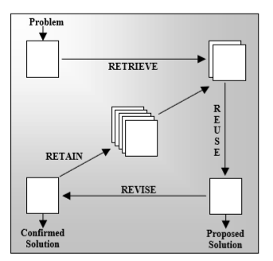
CBR Working Cycle
Four RE’s (Aamodt & Plaza, 1994):
Retrieve
Reuse
Revise
Retain
CBR Working Cycle (Pantic, n.d.)

Slide 7
Knowledge Containers
Vocabulary: knowledge required to choose features to describe the cases
Similarity: defines what makes two cases similar enough to reuse the solution
Adaptation: stores all knowledge about modifying the cases to solve new problems and the evaluation of the solutions suggested after modification
Case Base: knowledge about all of the cases stored in the system.
Knowledge Containers in CBR (Richter & Weber, 2013)

Slide 8
Case Representation
Cases can have three parts:
Problem Description
Problem Solution
Outcome
To keep the case base simple, normally only have problem description and problem solution
Two factors for what information to store in cases
The intended use of the system
How difficult it is to access the information

Slide 9
Indexing Cases
Indexes are used to ensure only relevant cases are retrieved from the case base.
The indexes should be:
Predictive: Helpful in predicting the relevance of a case.
Recognizable: The user can understand why this index is used.
Abstract: It’s possible to expand the existing case base with the index specified.
Concrete: Index is clear enough to help retrieve cases efficiently. (Pantic, n.d.)
Indexes can be modified as the system is used

Slide 10
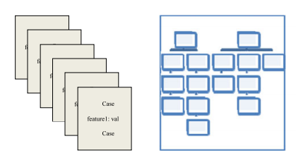
Organization of the Case Base
Three types of organization:
Flat organization: treats all cases like they’re not related
Clustered organization: clusters cases based on similarity
Hierarchical organization: Groups cases together based on similar features
Flat and Hierarchical Organization (Richter & Weber, 2013)

Slide 11
Case Retrieval
Most efficient case retrieval is the 1st nearest neighbor algorithm
Not efficient for large case bases
Techniques to speed up this algorithm are:
Preselecting cases: choosing a sample of cases to search through
Ranking cases: Rank cases based on how often they are retrieved
Parallel search: program the retrieval algorithm in parallel to speed up the retrieval of cases

Slide 12
Case Adaptation
Identify significant differences between the retrieved case and the current problem
Apply a set of rules to adapt the retrieved case solution
Two types of adaptation:
Structural adaptation: applies the chosen adaptation rules to the problem solutions in the selected cases
Derivational adaptation: reuses the methods that generated the solution to the retrieved case to create solution for the new problem
Normally adaptation is done by the user

Slide 13
Advantages and Disadvantages
Advantages
Disadvantages
Easy knowledge extraction
Cases can be reused easily
Incremental learning
Ease of explanation for case solution
Ease of maintenance
Handling large case bases
Case base may become outdated because the system favors methods that have worked before
Handling noisy data
No similar cases to problem in case base

Slide 14
References
Pantic, M. (n.d.). Introduction to Machine Learning & Case-Based Reasoning. Retrieved November 10, 2018, from https://ibug.doc.ic.ac.uk/media/uploads/documents/courses/syllabus-CBR.pdf.
Aamodt, A. and Plaza, E. (1994). CBR: foundational issues, methodological variations and system approaches. AI Communications, 7(1), pp. 39-59.
Richter, M. M. (1995). On the notion of similarity in case-based reasoning. Mathematical and Statistical Methods in Artificial Intelligence, G. della Riccia, R. Kruse, R. Viertl, (Eds.), pp. 171-184. Heidelberg, Germany: Springer-Verlag.
Kolodner, J. L. (1983). Reconstructive Memory: A Computer Model*, Cognitive Science, vol. 7, no. 4, pp. 281–328.
Lebowitz, M. (n.d). The Nature of Generalization In Understanding. Retrieved November 18, 2018, from https://www.ijcai.org/Proceedings/81-1/Papers/065.pdf
Richter, M. M., Weber, R. (2013). Chapter 2: Basic CBR Elements. Case-Based Reasoning (pp. 17 – 32). Retrieved on November 18, 2018, from https://www.springer.com/cda/content/document/cda_downloaddocument/9783642401664-c2.pdf?SGWID=0-0-45-1425809-p175373967
Watson , I. and Marir, F. (1994). Case-base reasoning: A review, The Knowledge Engineering Review, vol. 9, no. 4. pp. 327-354.
Mark, W., Simoudis, E., and Hinkle, D. (1996). Case-based reasoning: Expectations and results, Case-Based Reasoning: Experiences, Lessons & Future Directions, D.B. Leake, (Ed.), pp. 269-294, Publisher: AAAI Press, Menlo Park.

